Slide 1
Excel Training
Katie Kotynski
Conferencecorner.weebly.com

Slide 2
Conferencecorner.weebly.com
Pull down Microsoft tab
Click on Excel
Download the Workbook and Menu

Slide 3
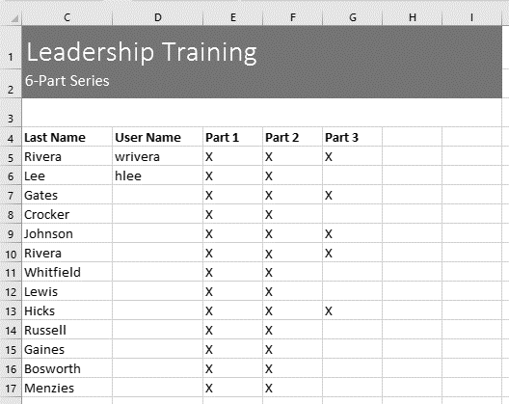
Let’s Review
Open the Leadership Worksheet.
Select cell D6 and type hlee.
Clear the contents in row 14.
Delete column G.
Using either cut and paste or drag and drop, move the contents of row 18 to row 14.
Use the fill handle to put an X in cells F9:F17.
Change the header to dark grey
When you're finished, your workbook should look like this:

Slide 4
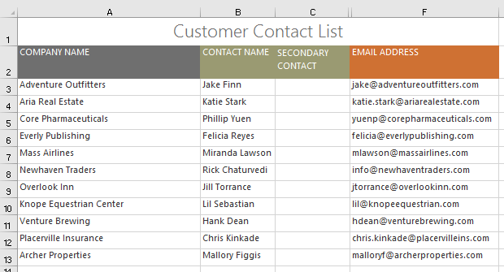
Practice arranging/merging cells
Open our Customer List Workbook
Autofit Column Width for the entire workbook.
Modify the row height for rows 3 to 14 to 22.5 (30 pixels).
Delete row 10.
Insert a column to the left of column C. Type SECONDARY CONTACT in cell C2.
Make sure cell C2 is still selected and choose Wrap Text.
Merge and Center cells A1:F1.
Hide the Billing Address and Phone columns.
When you're finished, your workbook should look something like this:

Slide 5
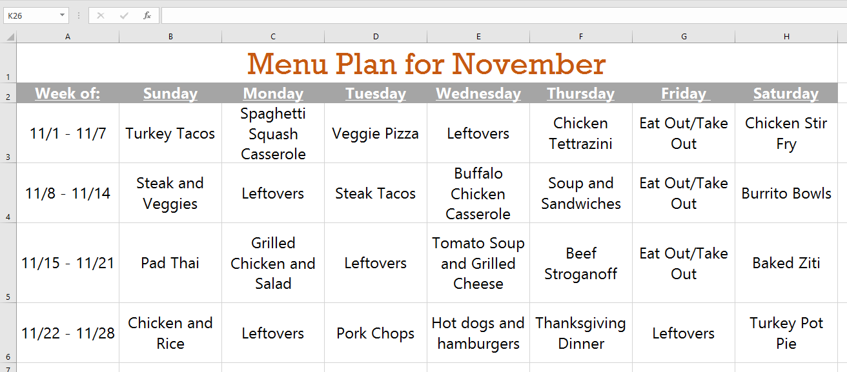
Make the Menu Plan look like this:

Slide 6
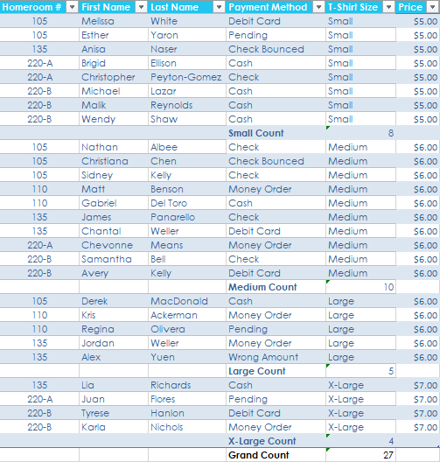
T-Shirt Counts
Add counts to the size column
Add table formatting

Slide 7
Help
Conferencecorner.weebly.com
Microsoft>Excel>Tutorials

Slide 8
