Slide 1
Web 2.0 Tools and then some more
Beth Thomas
beth_thomas@gfps.k12.mt.us
Miet2013.weebly.com
Great Falls Public Schools

Slide 2
Introductions
http://goo.gl/hi2Ro
On – line bulletin boards
Linoit.com
Padlet.com

Slide 3
Objectives:
1. Become familiar with useful Web 2.0 tools and on-line resources
2. Identify and share useful applications of these tools in the classroom.
3. Encourage/provide opportunities for your students to become producers, not consumers
Remember - Pedagogy must drive technology – collaboration and student engagement

Slide 4
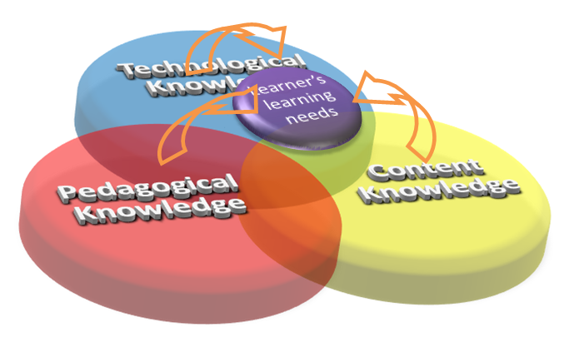

Slide 5
Web 1.0 vs 2.0
Talk amongst yourselves about the difference between Web 1.0 and 2.0 tools
Web 1.0 was used for information purposes – no way to engage or collaborate
Web 2.0 is an interactive platform which users can engage, collaborate and work in real-time.

Slide 6
Tool Comparison
Web 1.0
Application based
Isolated
Offline
Licensed/purchased
Single creator
Copyrighted content
Proprietary code
Web 2.0
Web based
Collaborative
Online
Free
Multiple collaborators
Open source
Shared content

Slide 7
Click on this link
http://goo.gl/hiW89

Slide 8
Tips for Using Wordle
To keep multi-word phrases together, use a tildee “~” between words.
Example: Web~2.0
A word maybe deleted from a Wordle cloud by right clicking on the word.
The higher the frequency of the word, the larger the word in the Wordle
A custom color palette may be created from the colors menu.
A summary of a news feed url may be entered and students may evaluate the resulting Wordle.

Slide 9
url shortener
Fur.ly
Goo.gl
https://bitly.com/
Tinyurl.com

Slide 10
Voki
free online service that allows the user to create personalized speaking avatars
Especially valuable when you want students to summarize or explain their thinking

Slide 11
Free tool allows you to capture motions and audio of a screen
Can publish it as a video file and save or put on You tube

Slide 12
Audio tools
Vocaroo – click here for an explanation!
Talk Typer
only with Chrome
Dictates
Howjsay.com (an app, too but costs $2.99)
Free online talking dictionary of English pronunciation
Can type in the word and hover over it to hear it pronounce
Apps - iPhone
Audioboo
Dragon Dictation

Slide 13
Fabulous video clip
http://goo.gl/VHO6r

Slide 14
Photo
Photosynth
Allows you to take panoramic pictures
Autocollage
Flickr

Slide 15
Graphing
Create a Graph (NCES)

Slide 16
YouTube
Log in with your google account to create your own channel
Add favorites and create playlists
Upload videos directly to your channel

Slide 17
Remindme101
Great communication tool for students and parents!

Slide 18
Music
Soundation
Songsmith
Jamsmith $

Slide 19
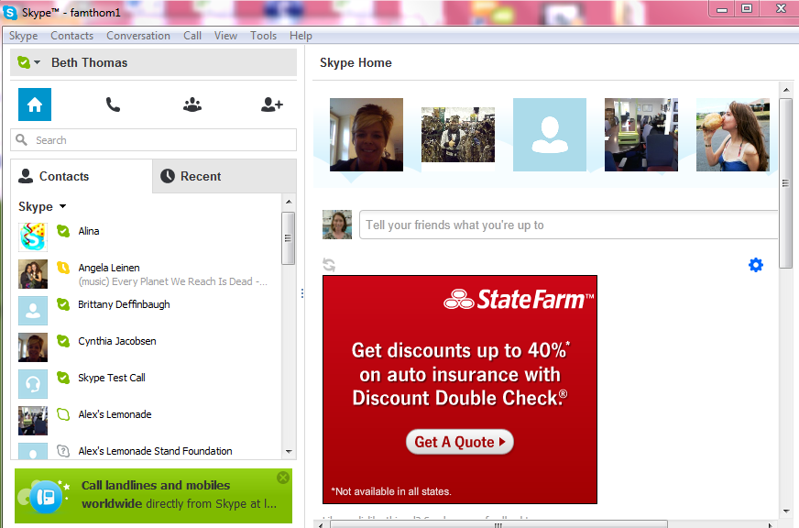
Skype
free internet calls with ability to include video
Messaging available

Slide 20
Other
StumbleUpon.com
Recitethis.com

Slide 21
Twitter
Cross between blogging and text messaging
With 140 character count limitation

Slide 22
KERPOOF (K-8)
Shared by Others
Spell A Picture
Make A Picture
Make A Movie
Make A Card
Make A Story
Doodle Pad
Make A Drawing

Slide 23
Google Earth
Google Earth
Lesson plans:
http://goo.gl/vSFcO
http://goo.gl/sLq3U

Slide 24
Drawing/PaintinG
Tuxpaint
Sumopaint.com
Drawzit.com
*Odosketch http://sketch.odopod.com

Slide 25
Educator communities/Resources
www.classroom20.com
*www.WizIQ (30 day free trial)
http://cooltoolsforschools.wikispaces.com/
partners in learning network PIL
http://www.freetech4teachers.com
http://www.schrockguide.net/index.html

